Slide 1

SUPERSTORE PERFORMANCE ANALYSIS
Izuchukwu Korie Octave Capstone Project.
Date: May 28, 2022

Slide 2
Table of content
1. Introduction
2. Background
3. Methodology
3. Analysis 4. Result & Insights 6. Conclusion & Recommendation

Slide 3
Introduction
Superstore was established in Kwara State in October 2010, and over the years has launched additional 9 stores across four states in the Federation including the Federal Capital Territory (FCT), Abuja.
The store is a proud supporter of Nigerian business and is committed to helping local enterprises, building relationships with leading Nigerian suppliers, small businesses and farmers, and securing a wide assortment of local brands.

Slide 4
Background
With growing demands and cut-throat competition in the market, the store is seeking knowledge in understanding what works best for them.
They would like to understand which;
Products
Regions
Categories
Customer segments
they should target or avoid.

Slide 5
Methodology
Approach and Timeline
May 9, 2022
May 10, 2022
May 25, 2022
May 28, 2022
1
2
3
4
Data and Requirement Gathering
-Data collection
- Understanding the business problem
Data Cleaning
-Exploratory data analysis
-Data quality issues
Data Analysis
Visualization
Analysis
Reports
Insights
Recommendation

Slide 6
Analysis
Data collection
The data used for this analysis was provided by Octave data team on 18th May 2022 .
Exploratory Analysis
Exploratory data analysis was performed in order to identify the quality of data such as identifying and excluding missing values, removing outliers, creating new variables from existing columns and converting the data types of variables as needed.
Additional manipulation of data included converting the sales and profit columns(represented as text ) into numerical columns and converting such columns as ship date into date fields as well.
Visualization
After the data quality check, the clean data was imported into Microsoft Power BI to build visualization and help to better understand the business problem.

Slide 7
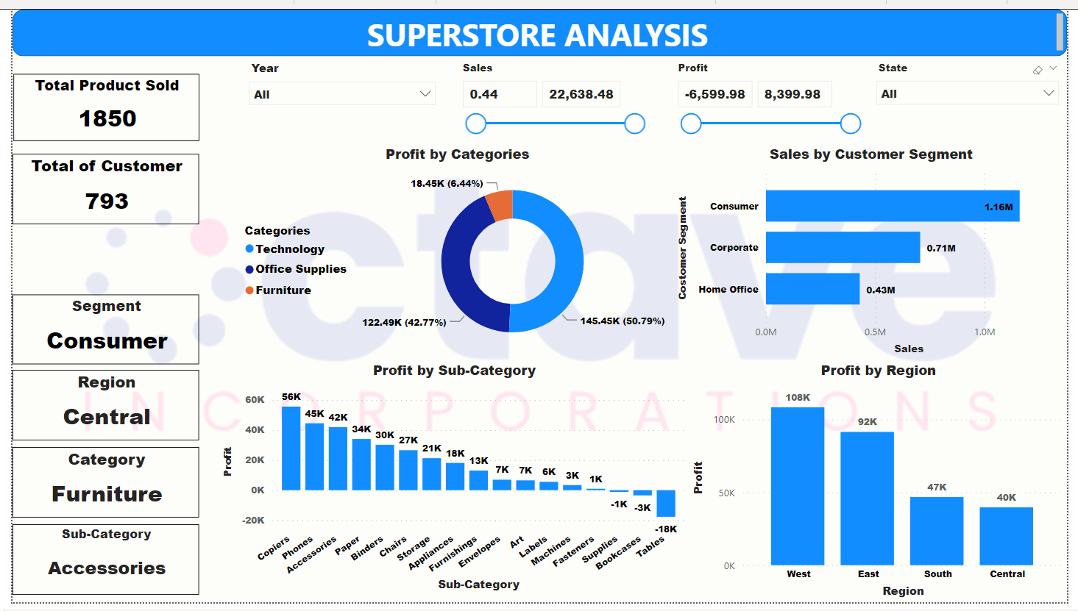
Analysis

Slide 8
Results & Insights
The dataset used for this analysis contains 9,995 records and 21 variables. There were seven missing values which were excluded from the analysis due to the fact they accounted for less than 0.1% of the total dataset and would have no significant impact on the overall data.
The simple Column chart (Profit by Customer segment) shows that the Consumer segment (1.6M) generated more sales than the corporate and Home office category, with Home office category having the lowest sales (0.43M).
From the Column chart (Profit by Sub-category), Copiers, Phone and Accessories are the top 3 sub-categories by the total profits generated. Contrarily, Tables, Bookcases and Supplies are the bottom 3 ranks by the total profit generated. This is because according to the doughnut chart, 50.79% of the client population belong this Technology category housing the top 3 sub-categories, while 6.44% of profits are generated by the Furniture category housing the bottom 3 sub-categories.
However, majority of products sold are bought by customers in the Consumer segment. This analysis further displays that majority of the products sold by this company are tailored towards this category’s need (accessories, phones, Copier and machines) and customers tend to buy more than the other categories.

Slide 9
Also, the results in the Profit by Region Column chart, shows the Western Region generates the highest profit while the least profit comes from the Central Region.
Furthermore, the analysis further shows that Technology category is driving more profit than any other category. This may be as a result of it having the highest quantity being sold.
The phone subcategory has the highest sales and a large number of quantities being sold but sub-categories like copiers generated more profit even when the quantities sold are just few.
Sub-categories like tables, bookcases etc are making a lot of sales but generating losses to the company. This could be that these products have been discounted and are being sold below cost price.
In summary, the total number of customer, and the total number of goods sold are 1850, 793 respectively, generating a total sale and profit of $22.6M and $8.3K respectively.
Results & Insights

Slide 10
Conclusion & Recommendation
The prices and discount on products generating losses to the company should be reviewed. The company should focus its products to the western region and improve their advertisements in the other regions.
More attention should be given to product categories and sub-categories that generate more profit for the company even when such Categories are not bought very frequently. This could be achieved by recommending the products in these categories to the customers especially those in the Consumer segment.
Introducing diverse, efficient, and widespread advertisements and broadcasts in other customer segments (especially the corporate segment) will contribute in driving more sales and profits to the company. Carrying out promo sales and discounts in the Home office region will be helpful in minimizing the amount of losses in the Tables, bookcases and supplies sub-categories.
The company should focus less strength in the Central region, furniture category and Home and office customer segment and still to efficient way of creating aware in these region, category, and customer segment.

